Slide 1
Face Mask Detection
Ahmed Mostafa Kamel
Eslam Taha Abd-Elrhim
Hossam Ahmed Thapit

Slide 2
Slides Content
Idea Representation
Learning
Development
Deployment

Slide 3
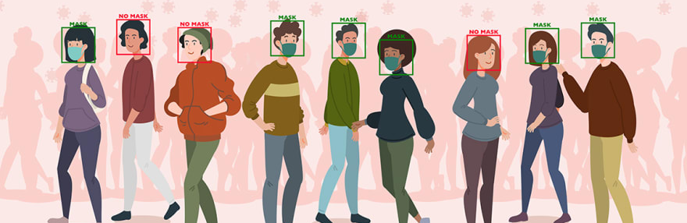


Idea Representation
Face-mask Detection in Real-time is a software that helps users to automatically identify whether someone or a group of people are wearing a face mask or not with the type of that mask in a real-time fashion.

Slide 4
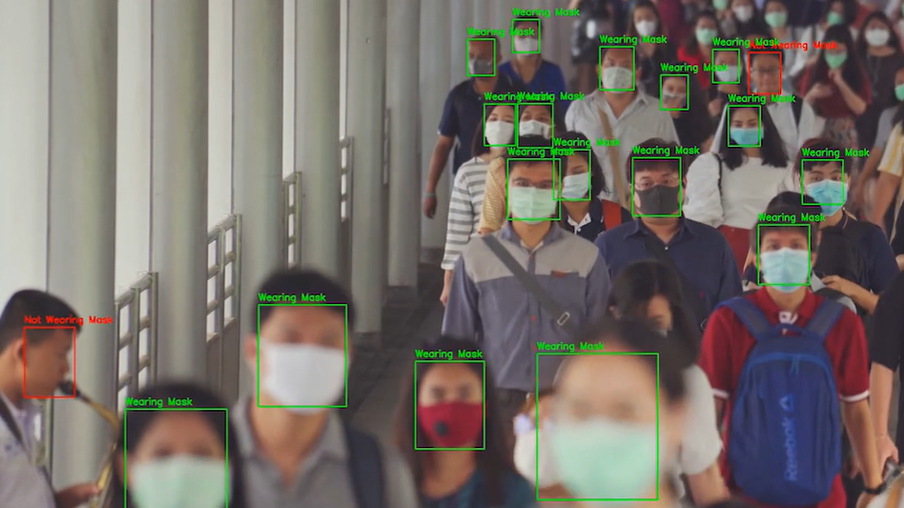
Institutions Monitoring
It can be used mainly in large institutions, especially governmental institutions for analytical purposes.
Some institutions could use it for medical purposes such as preventing the current pandemic of "covid-19" from being worse.

Slide 5

Learning
Coursera
Udacity
Kaggle

Slide 6
# | Course Name | Platform | Type | Start Date | Finish Date | Duration
1 | Machine Learning - Stanford | Coursera | Single Course | Dec 2, 2021 | Jan 27, 2021 | 57 Days
2 | Machine Learning Developer By Google | Qwiklabs | Badges/Quests | Jan 21, 2021 | Jan 24, 2021 | 4 Days
3 | Python | Kaggle | Single Course | Jan 27, 2021 | Jan 28, 2021 | 2 Day
4 | Intro to Machine Learning | Kaggle | Single Course | Jan 28, 2021 | Jan 29, 2021 | 2 Day
5 | Pandas | Kaggle | Single Course | Jan 29, 2021 | Jan 31, 2021 | 3 Day
6 | Neural Networks and Deep Learning | Coursera | Part of a Specialization | Fab 7, 2021 | Fab 11, 2021 | 5 Days
7 | AI Programming with Python | Udacity | Nanodegree | Fab 14, 2021 | Mar 26, 2021 | 41 days
8 | Improving Deep Neural Networks | Coursera | Part of a Specialization | Mar 22, 2021 | Apr 1, 2021 | 11 days
9 | Machine Learning Pipelines with Azure ML Studio | Coursera | Guided Projects | Apr 2, 2021 | Apr 2, 2021 | 3 Hours
10 | Structuring Machine Learning Projects | Coursera | Part of a Specialization | Soon | Soon | Soon
Total Days of Learning: 126 Day !!!

Slide 7
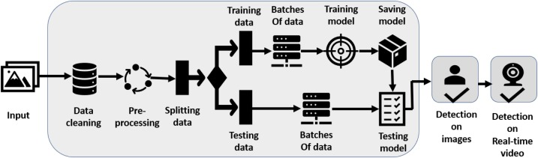
Development

Slide 8
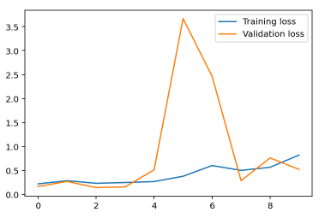
~70%

Slide 9
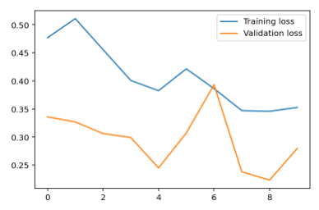
Epoch 1/10.. Train loss: 0.477.. Valid loss: 0.336.. Valid accuracy: 0.919
Epoch 2/10.. Train loss: 0.511.. Valid loss: 0.327.. Valid accuracy: 0.901
Epoch 3/10.. Train loss: 0.456.. Valid loss: 0.306.. Valid accuracy: 0.913
Epoch 4/10.. Train loss: 0.401.. Valid loss: 0.299.. Valid accuracy: 0.903
Epoch 5/10.. Train loss: 0.383.. Valid loss: 0.245.. Valid accuracy: 0.931
Epoch 6/10.. Train loss: 0.421.. Valid loss: 0.307.. Valid accuracy: 0.928
Epoch 7/10.. Train loss: 0.386.. Valid loss: 0.393.. Valid accuracy: 0.883
Epoch 8/10.. Train loss: 0.347.. Valid loss: 0.238.. Valid accuracy: 0.925
Epoch 9/10.. Train loss: 0.346.. Valid loss: 0.223.. Valid accuracy: 0.933
Epoch 10/10.. Train loss: 0.353.. Valid loss: 0.280.. Valid accuracy: 0.897
~90%

Slide 10
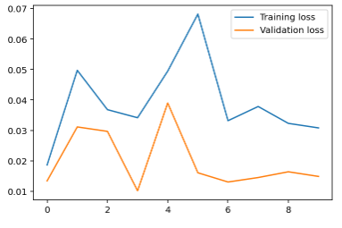
Transfer Learning
Epoch 1/10.. Train loss: 0.019.. Valid loss: 0.013.. Valid accuracy: 0.995
Epoch 2/10.. Train loss: 0.050.. Valid loss: 0.031.. Valid accuracy: 0.984
Epoch 3/10.. Train loss: 0.037.. Valid loss: 0.030.. Valid accuracy: 0.988
Epoch 4/10.. Train loss: 0.034.. Valid loss: 0.010.. Valid accuracy: 0.996
Epoch 5/10.. Train loss: 0.049.. Valid loss: 0.039.. Valid accuracy: 0.983
Epoch 6/10.. Train loss: 0.068.. Valid loss: 0.016.. Valid accuracy: 0.994
Epoch 7/10.. Train loss: 0.033.. Valid loss: 0.013.. Valid accuracy: 0.994
Epoch 8/10.. Train loss: 0.038.. Valid loss: 0.015.. Valid accuracy: 0.992
Epoch 9/10.. Train loss: 0.032.. Valid loss: 0.016.. Valid accuracy: 0.993
Epoch 10/10.. Train loss: 0.031.. Valid loss: 0.015.. Valid accuracy: 0.993
Average Loss: 0.001 Average Accuracy: 99.512% t

Slide 11
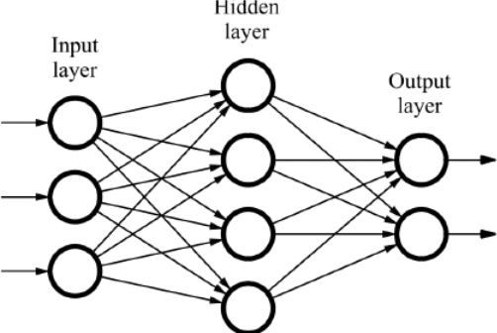
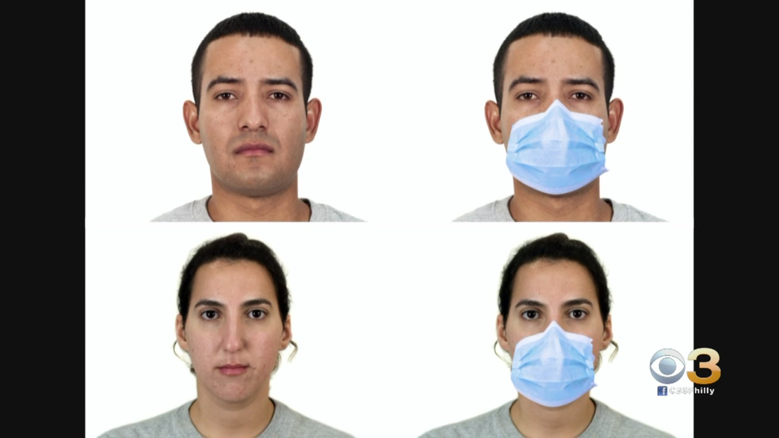
Baseline step
0 – No Mask
1 – With Mask
Detecting whether a mask exists for one person in an image.

Slide 12
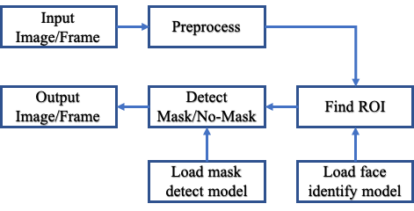

Slide 13
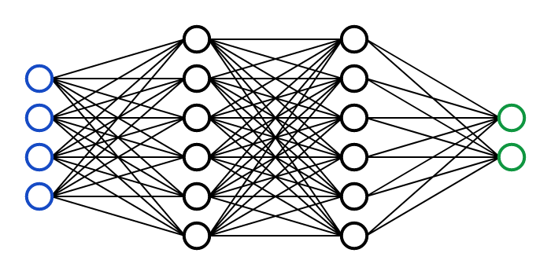
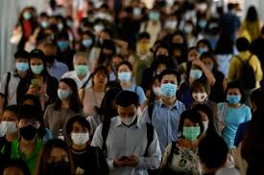
Second step
0 – No Mask
1 – With Mask
Detecting whether a mask exists for more than one person in an image.

Slide 14
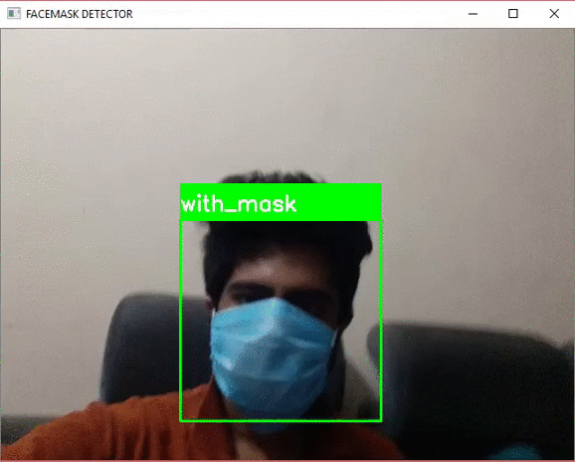
Third step
0 – No Mask
1 – With Mask
Real-Time Detection for more than one person in a video/stream.

Slide 15
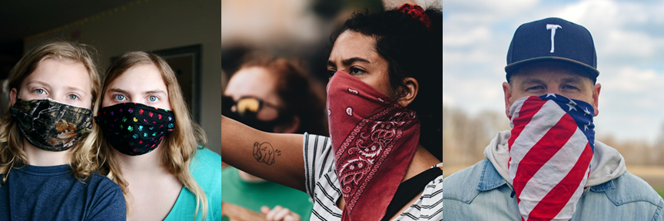
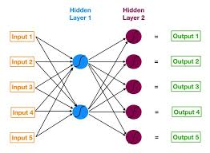

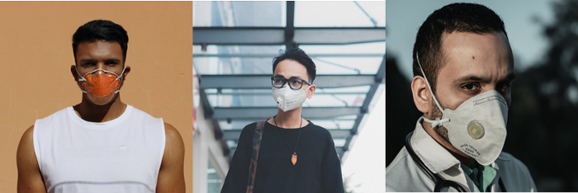
Additional step
Detecting the type of a mask.
Detection in real-time.
0 – No Mask
1 – Homemade
2 – Surgical
3 – N95
4- P100

